Slide 1
CROP PRODUCTION ANALYSIS

Slide 2
CONTENTS
CROP ANALYSIS
TOP CROPS
SEASON WISE CROPS
STATE WISE ANALYSIS
BEST PRODUCING STATE
CROP DIVERSITY IN STATES
PRIMARY CROP OF STATES
STATES WITH BEST PRODUCTION RATES
TRENDS IN PRODUCTION
STATE TRENDS

Slide 3
CROP ANALYSIS
Analyzing the Main Crops

Slide 4
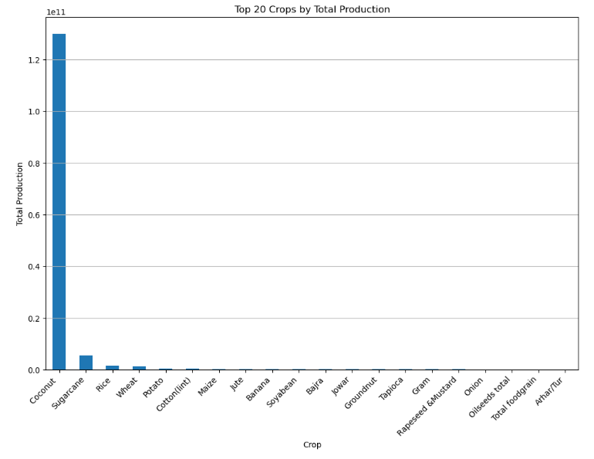
TOP CROPS
Coconut is the main crop produced in India.
Rice and Wheat being the largest consumed crop still stays on 3rd and 4th place respectively in production.

Slide 5
SEASON WISE CROPS
SEASON | Crops
Autumn | Rice, Maize, Paddy, Ragi, Jute
Kharif (Monsoon Season) | Sugarcane, Rice, Cotton (lint), Maize, Jute
Rabi (Winter Season) | Wheat, Potato, Gram, Rapeseed & Mustard, Rice
Summer | Rice, Maize, Bajra, Groundnut, Paddy
Whole Year | Coconut, Sugarcane, Potato, Banana, Tapioca
Winter | Rice, Paddy, Potato, Sugarcane, Urad

Slide 6
STATE WISE ANALYSIS
Analyzing production of crops over different states

Slide 7
BEST PRODUCING STATE
State Name | Area | Production
Kerala | 3.190807e+07 | 9.788005e+10
Andhra Pradesh | 1.315458e+08 | 1.732459e+10
Tamil Nadu | 9.589787e+07 | 1.207644e+10
Uttar Pradesh | 4.336316e+08 | 3.234493e+09
Assam | 7.037876e+07 | 2.111752e+09
West Bengal | 2.154052e+08 | 1.397904e+09
Maharashtra | 3.222062e+08 | 1.263641e+09
Karnataka | 2.029101e+08 | 8.634298e+08

Slide 8
CROP DIVERSITY IN STATES
State Name | Crop Count
Tamil Nadu | 87
Andhra Pradesh | 69
Telangana | 65
Madhya Pradesh | 62
Karnataka | 59
Rajasthan | 51
Kerala | 49
Nagaland | 48
Chhattisgarh | 46
West Bengal | 44
Haryana, Uttar Pradesh, Jammu and Kashmir, Bihar | 42
Manipur | 41
Assam, Meghalaya, Odisha, Uttarakhand | 39
Himachal Pradesh | 36

Slide 9
PRIMARY CROP OF STATES
State Name | Crop
Andaman and Nicobar Islands, Andhra Pradesh, Assam, Goa, Kerela, Puducherry, Tamil Nadu, Telangana, West Bengal | Coconut
Arunachal Pradesh, Chhattisgarh, Jharkhand, Manipur, Meghalaya, Mizoram, Nagaland, Odisha, Tripura | Rice
Bihar, Gujrat, Dadra and Nagar Haveli, Karnataka, Maharashtra, Uttar Pradesh, Uttarakhand | Sugarcane
Chandigarh, Haryana, Madhya Pradesh, Punjab, Rajasthan | Wheat
Himachal Pradesh, Jammu and Kashmir | Maize

Slide 10
STATES WITH BEST PRODUCTION RATES
State Name | Area | Production | Production per Area
Kerala | 3.190807e+07 | 9.788005e+10 | 3067.563634
Andaman and Nicobar Islands | 3.378961e+05 | 7.182232e+08 | 2125.574411
Puducherry | 5.487420e+05 | 3.847245e+08 | 701.102708
Goa | 1.205680e+06 | 5.057558e+08 | 419.477430
Andhra Pradesh | 1.315458e+08 | 1.732459e+10 | 131.700020
Tamil Nadu | 9.589787e+07 | 1.207644e+10 | 125.930257
Assam | 7.037876e+07 | 2.111752e+09 | 30.005528
Uttar Pradesh | 4.336316e+08 | 3.234493e+09 | 7.459079
Uttarakhand | 1.879318e+07 | 1.321774e+08 | 7.033262

Slide 11
TRENDS IN PRODUCTION
Analyzing the trends in production for different states

Slide 12
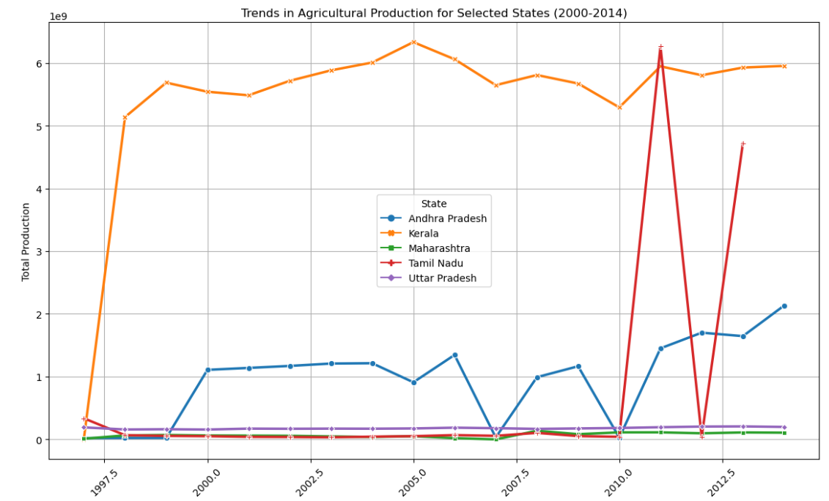
STATE TRENDS
Kerela has always been the highest producing with little fluctuations.
Andhra Pradesh have been constant till 2006 but fluctuating after that with a continuous increase after 2010.
Tamil Nadu increased the production in 2011 beating Kerela also.

Slide 13
Thank You
Name:- Aayush Khanna
Phone:- +91 7351830828
Email:- aayushkhanna0201@gmail.com
LinkedIn:- https://www.linkedin.com/in/aayush-khanna-0192a6219/
GitHub:- https://github.com/aayush674

